Slide 1
AVR Interfacing Timer

Slide 2
Agenda
Introduction to AVR Timer.
AVR Overflow mode
AVR Compare match mode (CTC)
AVR Pulse width modulation mode (PWM).

Slide 3
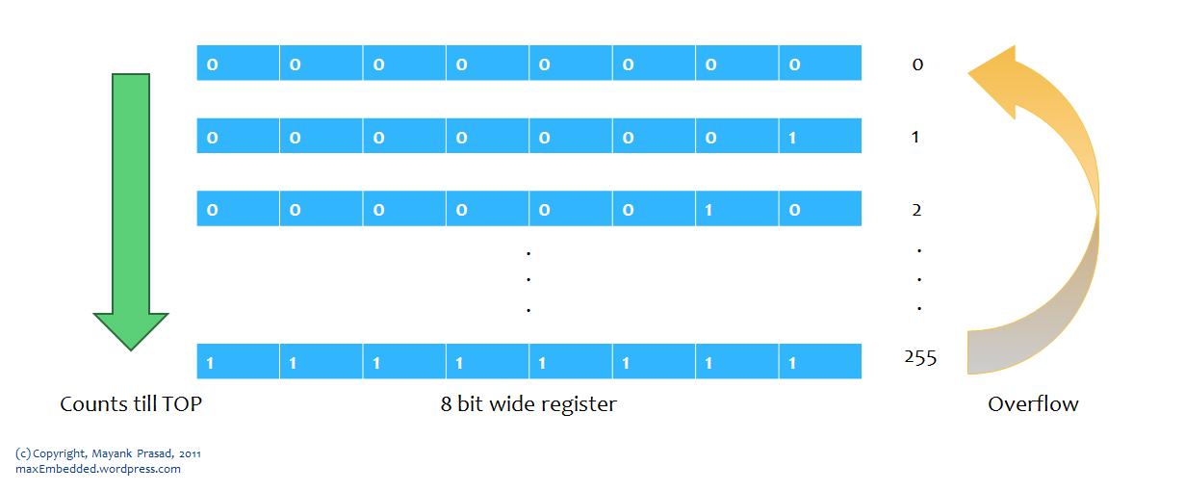
Timer Introduction
Timers is an important concept in the field of electronics. It can be generated a time base using a timer circuit, using a microcontroller, etc.
In Microcontroller, timer is a register, but not a normal one.
The value of this register increases/decreases automatically.
In AVR, timers are of two types: 8-bit and 16-bit timers.
In an 8-bit timer, the register used is 8-bit wide whereas in 16-bit timer, the register width is of 16 bits.
The 8-bit timer is capable of counting 2^8=256 steps from 0 to 255 as demonstrated below. A 16 bit timer is capable of counting 2^16=65536 steps from 0 to 65535.

Slide 4


Timer Introduction
Timer can be used as
Precise timer
Counter
PWM (Pulse width modulation)
ICU (Input Capture unit)
The best part is that the timer is totally independent of the CPU. Thus, it runs parallel to the CPU and there is no CPU’s intervention, which makes the timer quite accurate.
If Microcontroller works at frequency=4MHz, hence the timer will take 1/freq= 1/4M =0.00025 ms for the one count that called “system tick”.
To calculate the number of counts needed for a specific delay the following formula is used:

Slide 5
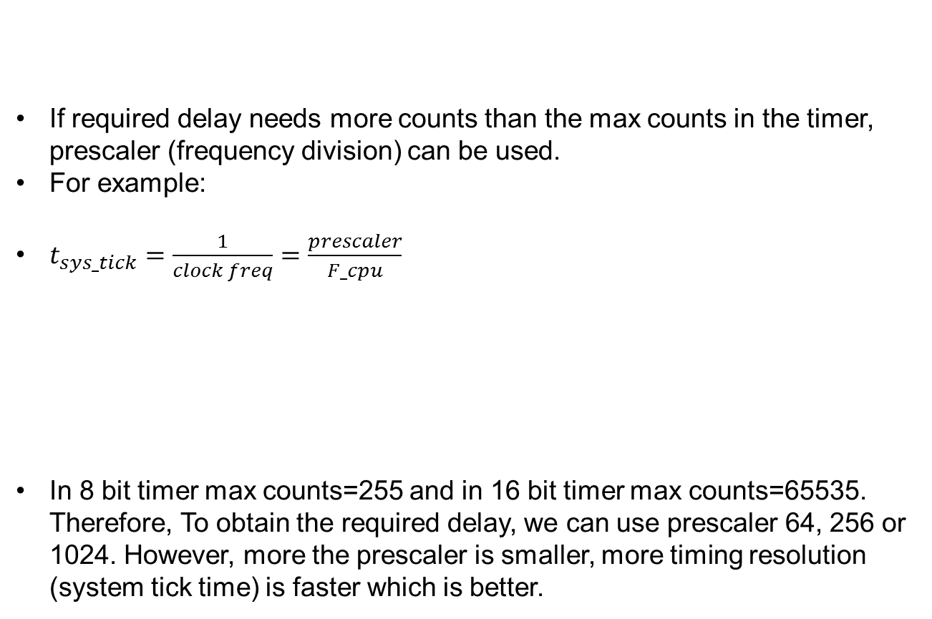
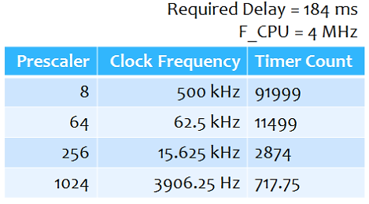
Timer Introduction

Slide 6
AVR Overflow mode
Problem Statement
Let’s define a problem statement for us. The simplest one being the LED flasher. Let’s say, we need to flash an LED every 6 ms and we are have a CPU clock frequency of 32 kHz.
Methodology
Now, as per the following formula, with a clock frequency of 32 kHz and 8-bit counter, the maximum delay possible is of 8 ms. This is quite low. Hence for a delay of 6 ms, we need a timer count of 191. This can easily be achieved with an 8-bit counter (MAX = 255).
Thus, what we need to do is quite simple. We need to keep a track of the counter value. As soon as it reaches 191, we toggle the LED value and reset the counter.

Slide 7

AVR Overflow mode
In AVR, there are three types of timers Timer0, Timer1 and Timer2
TIMER1 is a 16-bit timer whereas others are 8-bit timers.
To configure the timer as we need. Knowing the registers details will the help.
TCNT0 Register Timer/Counter Register
This is where the 8-bit counter of the timer resides. The value of the counter is stored here and it increases automatically each clock cycle. Data can be both read/written from this register. The initial value of the counter is set by writing it.

Slide 8
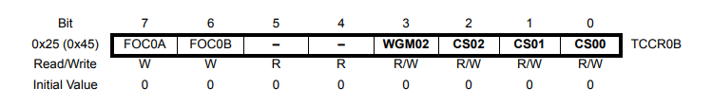
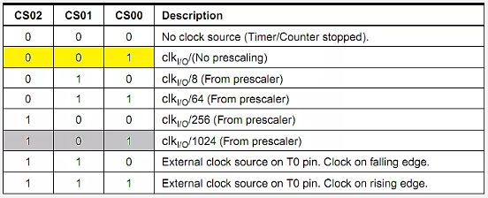
AVR Overflow mode
TCCR0B Register – Timer/Counter Control Register B
Right now, we will concentrate on the highlighted bits. The other bits will be discussed as and when necessary. By selecting these three Clock Select Bits, CS02:00, we set the timer up by choosing proper prescaler. The possible combinations are shown below.

Slide 9
AVR Overflow mode
For the previous Problem statement example: we need to flash an LED every 6 ms and we are have a CPU clock frequency of 32 kHz.
#include <avr/io.h>
void timer0_init(){
// set up timer with no prescaling
TCCR0B |= (1 << CS00);
// initialize counter
TCNT0 = 0;}
void main(void){
// connect led to pin PC0
DDRC |= (1 << 0);
// initialize timer
timer0_init();
while(1){
// check if the timer count reaches 191
if (TCNT0 >= 191){
PORTC ^= (1 << 0); // toggles the led
TCNT0 = 0; // reset counter
}
}
}

Slide 10
AVR Overflow mode
Problem Statement Redefined Again
Let’s flash an LED every 50 ms with CPU frequency 16 MHz using Interrupt.
The concept here is that the hardware generates an interrupt every time the timer overflows. Since the required delay is greater than the maximum possible delay, obviously the timer will overflow. And whenever the timer overflows, an interrupt is fired. Now the question is how many times should the interrupt be fired?
For this, let’s do some calculation. it should take 4.096 ms for the timer to overflow. Now as soon as the timer overflows, an interrupt is fired and an Interrupt Service Routine (ISR) is executed. Now,
50 ms ÷ 4.096 ms = 12.207

Slide 11
AVR Overflow mode
Problem Statement Redefined Again
The timer has overflown 12 times, 49.152 ms would have passed. After that, when the timer undergoes 13th iteration, it would achieve a delay of 50 ms. Thus, in the 13th iteration, we need a delay of 50 – 49.152 = 0.848 ms. At a frequency of 62.5 kHz (prescaler = 256), each tick takes 0.016 ms. Thus to achieve a delay of 0.848 ms, it would require 53 ticks. Thus, in the 13th iteration, we only allow the timer to count up to 53, and then reset it. All this can be achieved in the ISR as follows:
// global variable to count the number of overflows
volatile uint8_t tot_overflow;
// TIMER0 overflow interrupt service routine
// called whenever TCNT0 overflows
ISR(TIMER0_OVF_vect)
{
// keep a track of number of overflows
tot_overflow++;
}
Notes:
This code is used to handle Timer0 Overflow Interrupt in an AVR microcontroller (such as ATmega328P used in Arduino UNO). Let’s break it down:
1. volatile uint8_t tot_overflow;
volatile: Prevents the compiler from optimizing this variable, as it is modified inside an interrupt service routine (ISR).
uint8_t: An 8-bit unsigned integer (0 to 255).
tot_overflow: This variable counts the number of times Timer0 overflows.
2. ISR(TIMER0_OVF_vect)
This is the Interrupt Service Routine (ISR) for Timer0 Overflow.
TIMER0_OVF_vect is a predefined vector in AVR interrupt vector table.
It gets automatically executed whenever Timer0 overflows (when TCNT0 reaches 255 and resets to 0).
Inside the ISR, tot_overflow++ increments the counter to track how many overflows have occurred.
Each ISR resets the flag after its function is done.
After the flag is reset then the timer continues its function.

Slide 12
AVR Overflow mode
void main(void)
{
// connect led to pin PC0
DDRC |= (1 << 0);
// initialize timer
timer0_init();
// loop forever
while(1){
// check if no. of overflows = 12
if (tot_overflow >= 12) // NOTE: '>=' is used
{
// check if the timer count reaches 53
if (TCNT0 >= 53){
PORTC ^= (1 << 0); // toggles the led
TCNT0 = 0; // reset counter
tot_overflow = 0; // reset overflow counter
}
}
}
}

Slide 13

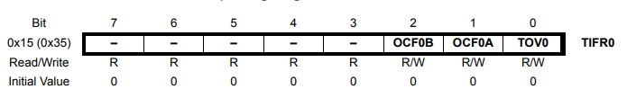
AVR Overflow mode
How to enable the interrupt feature. For this, you should be aware of the following registers.
TIMSK0 Register – Timer/Counter Interrupt Mask Register
It is a common register for all the three timers. Setting TOIE0 (Timer/Counter0 Overflow Interrupt Enable) bit to ‘1’ enables the TIMER0 overflow interrupt.
TIFR Register (Flag register) – Timer/Counter 0 Interrupt Flag Register
The bit TOV0 (Timer/Counter0 Overflow Flag) is set (one) when an overflow occurs in Timer/Counter0. TOV0 is cleared by hardware when executing the corresponding interrupt handling vector.

Slide 14
AVR Overflow mode
Enabling Global Interrupts
In the AVRs, there’s only one single bit which handles all the interrupts. Thus, to enable it, we need to enable the global interrupts. This is done by calling a function named sei(). According to the previous regs the init function will be as follows:
#include <avr/io.h>
#include <avr/interrupt.h>
// initialize timer, interrupt and variable
void timer0_init(){
// set up timer with prescaler = 256
TCCR0B |= (1 << CS02);
// initialize counter
TCNT0 = 0;
// enable overflow interrupt
TIMSK0 |= (1 << TOIE0);
// enable global interrupts
sei();
// initialize overflow counter variable
tot_overflow = 0; }

Slide 15
AVR Compare match mode (CTC)
AVR timers can operate not only in overflow mode but there are different modes it can be operated in as follows:
Normal mode (Overflow).
Clear Timer on Compare mode (CTC) or Compare Match mode.
Pulse Width Modulation mode (PWM).
Clear Timer on Compare (CTC) Mode:
Suppose that We had two timer values with us – Set Point (SP) and Process Value (PV). In every iteration, we used to compare the process value with the set point. Once the process value becomes equal (or exceeds) the set point, the process value is reset.

Slide 16

AVR Compare match mode (CTC)
Problem Statement
We need to flash an LED every 100 ms with CPU frequency 16 MHz.
Methodology – Using CTC Mode
Now, given Freq_CPU = 16 MHz, with a prescaler of 64, the frequency of the clock pulse reduces to 250 kHz. With a Required Delay = 100 ms, we get the Timer Count to be equal to 24999. Up until now, we would have let the value of the timer increment, and check its value every iteration, whether it’s equal to 24999 or not, and then reset the timer. Now, the same will be done in hardware! We won’t check its value every time in software! We will simply check whether the flag bit is set or not.

Slide 17


AVR Compare match mode (CTC)
Now, let me introduce you to the register bits which help you to implement this CTC Mode.
TCCR1A and TCCR1B Registers (Timer/Counter1 Control Register)
We are already aware of the Clock Select Bits – CS12:10 which set the prescaler.
Right now, we are concerned with the Wave Generation Mode Bits – WGM13:10. which configures the operating mode of the timer. We have discussed before normal mode (overflow mode)

Slide 18
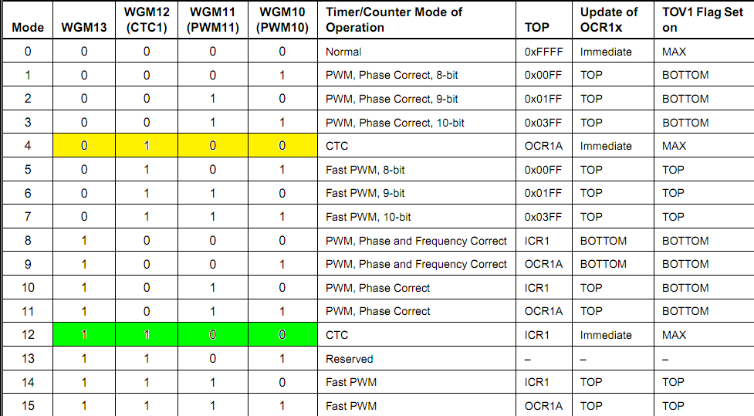
AVR Compare match mode (CTC)
The following table shows how to configure the different modes by configure the values of WGM13:0
We have discussed before normal mode (overflow mode) which requires WGM13:0=0000. By default, these bit are zero unless it is not configured.

Slide 19
AVR Compare match mode (CTC)
See that there are two possible selections for CTC Mode. Practically, both are the same, except the fact that we store the timer compare value in different registers. Right now, let’s move on with the first option (0100). Thus, the initialization of TCCR1A and TCCR1B is as follows.
//Mode CTC and prescaler= 64
TCCR1A |=0;
TCCR1B |=(1<< WGM12)
| (1<< CS00)
| (1<< CS01);

Slide 20


AVR Compare match mode (CTC)
OCR1A and OCR1B Registers Output Compare Register
OCR register is a register which we store the compared value with in it.

Slide 21

AVR Compare match mode (CTC)
TIFR1 Register (Timer/Counter1 Interrupt Flag Register)
We are interested in Bit 2:1 – OCF1A:B – Timer/Counter1, Output Compare A/B Match Flag Bit. This bit is set (one) by the AVR whenever a match occurs i.e. TCNT1 becomes equal to OCR1A (or OCR1B). It is cleared automatically whenever the corresponding Interrupt Service Routine (ISR) is executed. Alternatively, it can be cleared by writing ‘1’ to it!
Now return back to our problem statement: We need to flash an LED every 100 ms with CPU frequency 16 MHz using timer1 in AVR.
#include <avr/io.h>
// initialize timer, interrupt and variable
void timer1_init(){
// set up timer with prescaler = 64 and CTC mode
TCCR1B |= (1 << WGM12)|(1 << CS01)|(1 << CS00);
// initialize counter
TCNT1 = 0;
// initialize compare value
OCR1A = 24999;
}

Slide 22
AVR Compare match mode (CTC)
void main(void)
{
// connect led to pin PC0
DDRC |= (1 << 0);
// initialize timer
timer1_init();
while(1)
{
// check whether the flag bit is set
// if set, it means that there has been a compare match
// and the timer has been cleared
// use this opportunity to toggle the led
if (TIFR1 & (1 << OCF1A)) // NOTE: '>=' used instead of '=='
{
PORTC ^= (1 << 0); // toggles the led
}
// wait! we are not done yet!
// clear the flag bit manually since there is no ISR to execute
// clear it by writing '1' to it (as per the datasheet)
TIFR1 |= (1 << OCF1A);
}
}

Slide 23

AVR Compare match mode (CTC)
Methodology – Using Interrupts with CTC Mode
In the previous methodology, we simply used the CTC Mode of operation. We used to check every time for the flag bit (OCF1A). Now let’s shift this responsibility to the AVR itself. now we do not need to check for the flag bit at all! The AVR will compare TCNT1 with OCR1A. Whenever a match occurs, it sets the flag bit OCF1A, and also fires an interrupt.
There are three kinds of interrupts in AVR – overflow, compare and capture. We have already discussed the overflow interrupt. For this case, we need to enable the compare interrupt. The following register is used to enable interrupts.
TIMSK1 Register – Timer/Counter1 Interrupt Mask Register
We have already come across TOIE1 bit. Now, the Bit 2:1 – OCIE1A:B – Timer/Counter1, Output Compare A/B Match Interrupt Enable bits are of our interest here. Enabling it ensures that an interrupt is fired whenever a match occurs. Since there are two CTC channels (unit) in Timer1, we have two different bits OCIE1A and OCIE1B for them.

Slide 24
AVR Compare match mode (CTC)
Now let’s proceed to write an ISR for this. The ISR is defined as follows:
Note: Executing the ISR clears the
OCF1A flag bit automatically and the
timer value (TCNT1) is reset.
Init function will be as follows:
ISR (TIMER1_COMPA_vect)
{
// toggle led here
PORTB ^=(1<<0);
}
#include <avr/io.h>
#include <avr/interrupt.h>
// initialize timer, interrupt and variable
void timer1_init(){
// set up timer with prescaler = 64 and CTC mode
TCCR1B |= (1 << WGM12)|(1 << CS01)|(1 << CS00);
// initialize counter
TCNT1 = 0;
// initialize compare value
OCR1A = 24999;
// enable compare interrupt
TIMSK1 |= (1 << OCIE1A);
// enable global interrupts
sei();
}

Slide 25
AVR Compare match mode (CTC)
void main(void)
{
// connect led to pin PC0
DDRC |= (1 << 0);
// initialize timer
timer1_init();
// loop forever
while(1)
{
// do nothing
// whenever a match occurs, ISR is fired
// toggle the led every 100ms in the ISR itself
// no need to keep track of any flag bits here
// done!
}
}
Now, we have seen how to implement the CTC mode using interrupts, reducing the code size, comparisons and processing time.

Slide 26
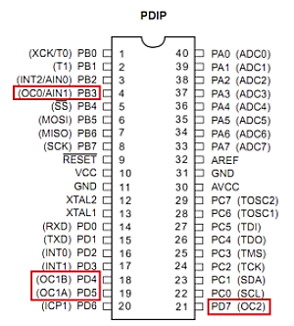

AVR Compare match mode (CTC)
Methodology – Using Hardware CTC Mode
The pins PD6, PD5, PB1, PB2, PB3 and PD3 have their special functions are mentioned in the brackets (OC0A, OC0B, OC1A, OC1B , OC2A and OC2A). These are the Output Compare pins of TIMER0, TIMER1 and TIMER2 respectively.
TCCR1A Register Timer/Counter1 Control Register A
Now time for us to concentrate on Bit 7:6 – COM1A1:0
and Bit 5:4 – COM1B1:0 – Compare Output Mode for
Compare Unit A/B. These bits control the behavior of
the Output Compare (OC) pins.
The behavior changes depending upon the following modes:
Non-PWM mode (normal / CTC mode)
Fast PWM mode
Phase Correct / Phase & Frequency Correct PWM mode

Slide 27
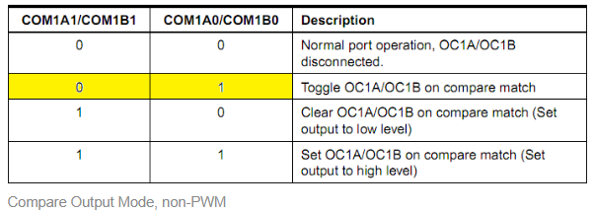
AVR Compare match mode (CTC)
The following options hold good for non-PWM mode
Since we need to toggle the LED, we choose the second option (01). Well, that’s all we need to do! No need to check any flag bit, no need to attend to any interrupts, nothing. Just set the timer to this mode and we are done! Whenever a compare match occurs, the OC1A pin is automatically toggled.
But we need to compromise on the hardware. Only PB1 or PB2 (OC1A or OC1B) can be controlled this way, which means that we should connect the LED to PB1 (since we are using channel A) instead of PC0 (which we had been using in all the examples till now).

Slide 28
AVR Compare match mode (CTC)
#include <avr/io.h>
#include <avr/interrupt.h>
// initialize timer, interrupt and variable
void timer1_init()
{
// set up timer with prescaler = 64 and CTC mode
TCCR1B |= (1 << WGM12)|(1 << CS01)|(1 << CS00);
// set up timer OC1A pin in toggle mode
TCCR1A |= (1 << COM1A0);
// initialize counter
TCNT1 = 0;
// initialize compare value
OCR1A = 24999;
}
void main(void){
// connect led to pin PB1
DDRB |= (1 << 1);
// initialize timer
timer1_init();
while(1){
// do nothing
// whenever a match occurs
// OC1A is toggled automatically!
// no need to keep track of any flag bits or ISR
}
}

Slide 29
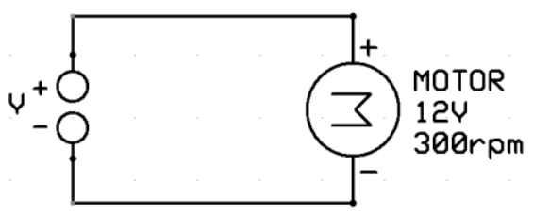
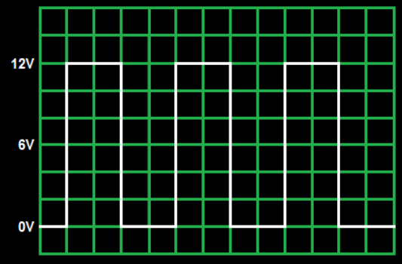
AVR Pulse width modulation mode (PWM)
Pulse Width Modulation (PWM) is a very common technique in telecommunication and power control. It is basically a modulation technique, in which the width of the carrier pulse is varied in accordance with the analog message signal.
Let us assume that a DC motor is connected to the power supply as follows
The motor is rated 12V/300rpm. This means that (assuming ideal conditions) the motor will run at 300 rpm only when 12V DC is supplied to it. If we apply 6V, the motor will run at only 150 rpm.
Let us ask what will happen if we apply a periodic signal as shown?
It takes some time to reach its full speed. But before it happens, it is powered off, and so on. Thus, the overall effect of this action is that the motor rotates continuously, but at a lower speed. In this case, the motor will behave exactly as if a 6V DC is supplied to it, i.e. rotate at 150 rpm.

Slide 30
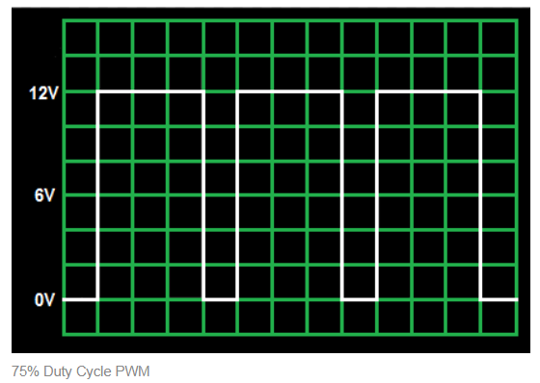
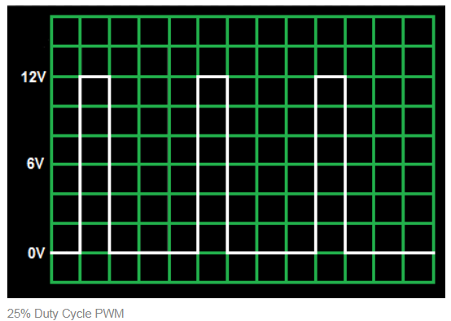
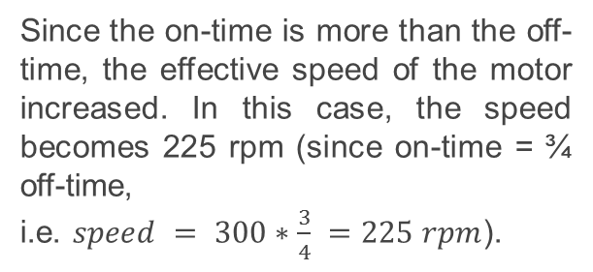
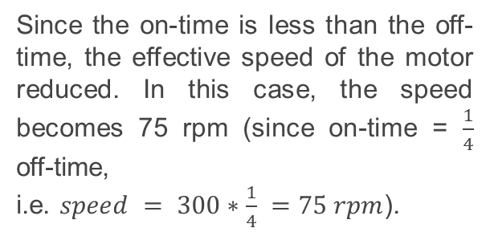
AVR Pulse width modulation mode (PWM)
This is what we call Pulse Width Modulation, commonly known as PWM.

Slide 31
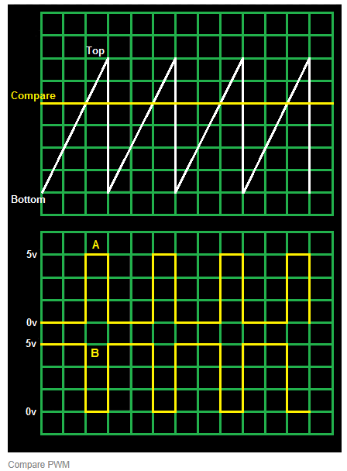
AVR Pulse width modulation mode (PWM)
The simplest way to generate a PWM signal is by comparing the a predetermined waveform with a fixed voltage level as shown below.
In the Figure shown, we have a predetermined waveform, sawtooth waveform. We compare this waveform with a fixed DC level. It has three compare output modes of operation:
Inverted Mode: In this mode, if the waveform value is greater than the compare level, then the output is set high, or else the output is low. This is represented in figure A.
Non-Inverted Mode: In this mode, the output is high whenever the compare level is greater than the waveform level and low otherwise. This is represented in figure B.
Toggle Mode: In this mode, the output toggles whenever there is a compare match. If the output is high, it becomes low, and vice-versa.

Slide 32
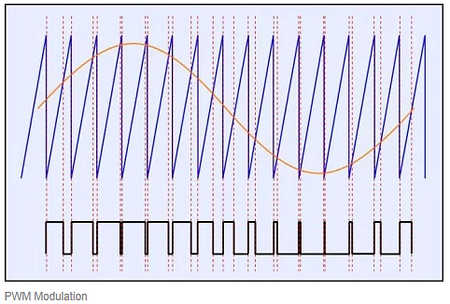
AVR Pulse width modulation mode (PWM)
It’s always not necessary that we have a fixed compare level. Those who have had exposure in the field of analog/digital communication must have come across cases where a sawtooth carrier wave is compared with a sinusoidal message signal as shown below.

Slide 33

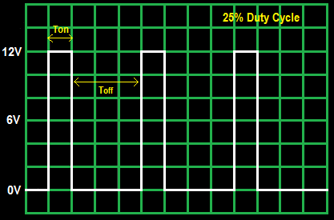
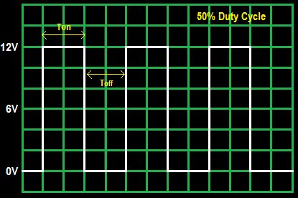
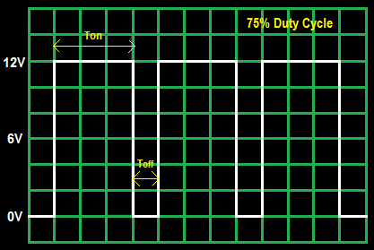
AVR Pulse width modulation mode (PWM)
Duty Cycle
The Duty Cycle of a PWM Waveform is given by

Slide 34
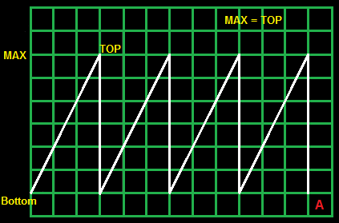
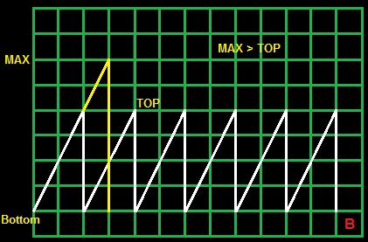
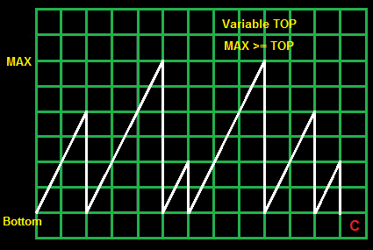
AVR Pulse width modulation mode (PWM)
Consider the following timer diagram:
We are very well aware that the AVR provides us with an option of 8 and 16 bit timers. 8bit timers count from 0 to 255, then back to zero and so on. 16bit timers count from 0 to 65535, then back to zero. Thus for a 8bit timer, MAX = 255 and for a 16bit timer, MAX = 65535.
The timer always counts from 0 to TOP, then overflows back to zero. In figure A shown above, TOP = MAX.
Due to this, the value of TOP can be reduced as shown in figure B. The yellow line shows how the timer would have gone in normal mode.
Now, the CTC Mode can be extended to introduce variable TOP as shown in figure C

Slide 35
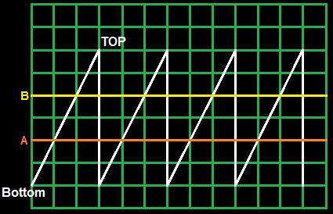
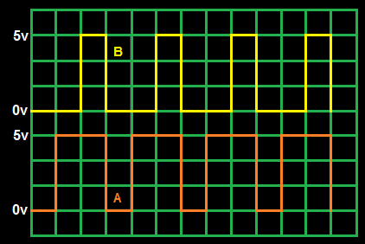
AVR Pulse width modulation mode (PWM)
PWM Modes of Operation:
There are three modes of operation of PWM Timers:
Fast PWM
Phase Correct PWM
Frequency and Phase Correct PWM
Fast PWM
We have a sawtooth waveform, and we compare it with a fixed voltage level (say A), and thus we get a PWM output as shown (in A). Now suppose we increase the compare voltage level (to, say B). In this case, as we can see, the pulse width has reduced, and hence the duty cycle. But, as you can see, both the pulses (A and B) end at the same time irrespective of their starting time.

Slide 36
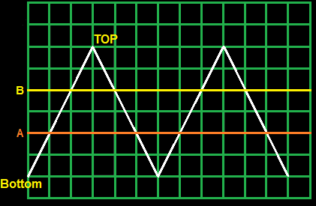
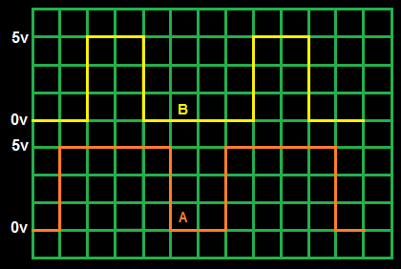
AVR Pulse width modulation mode (PWM)
Phase Correct PWM
Here instead of a sawtooth waveform, we have used a triangular waveform. Even here, you can see how PWM is generated. We can see that upon increasing the compare voltage level, the duty cycle reduces. But unlike Fast PWM, in Phase correct PWM, both the pulses (A and B) end and start in different time.
By visual inspection, we can clearly see that the frequency of Fast PWM is twice that of Phase Correct PWM.

Slide 37
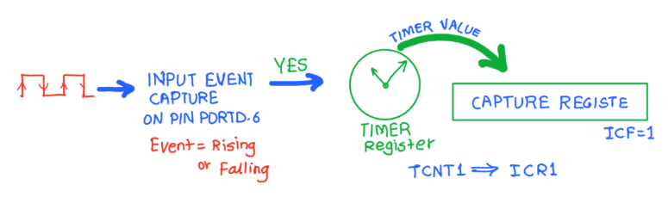
AVR Timer Input Capture Mode (ICU)
An Input Capture unit is a peripheral that is able to listen from an input pin in MCU, if any transition change (HIGH to LOW or vice versa ) happens on this pin, a flag will be raised and time will be captured and saved into a register.
Input capture function is used in many applications such as:
Pulse width measurement
Period measurement
Capturing the time of an event
In AVR ATmega32, Timer1 can be used as an input capture to detect and measure events happening outside the microcontroller. Upon detection of a defined event i.e. rising edge or falling edge on ICP1 pin (PORTB.0), TCNT1(Timer / Counter register) value is loaded into the ICR1 (input capture) register and the ICF1 (in TIFR1) flag will get set.

Slide 38

AVR Timer Input Capture Mode (ICU)
Programming:
TCCR1B: Timer Counter Control Register B
Bit 7 - ICNC1: Input Capture Noise canceller
Setting this bit activates noise canceller. It causes a delay of 4 clock
cycles as it considers a change only if it persists for at least 4 successive system clocks.
Bit 6 - ICES1: Input Capture Edge select
Select edge detection for input capture function.
0 = Capture on falling edge
1 = Capture on rising edge
Bit 4: 3 - WGM13 : WGM12: Timer1 Mode select
These bits are used for mode selection like Normal mode, PWM mode, CTC mode etc. here we will select normal mode, so set these bits to zero.

Slide 39
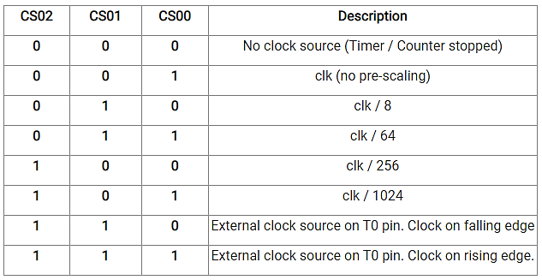
AVR Timer Input Capture Mode (ICU)
Programming:
TCCR1B: Timer Counter Control Register B
Bit 2: 0 - CS12: CS10:Timer1 Clock Select

Slide 40
AVR Timer Input Capture Mode (ICU)
Programming:
Steps to Program
Initialize the TCCR1A and TCCR1B for proper timer mode (any mode other than 8, 10, 12, 14), to select the edge (Positive or Negative).
Monitor the ICF1 flag in TIFR register to see if edge is arrived. Upon the arrival of the edge, the TCNT1 value is loaded in to ICR1 register automatically by controller.
Note: The Input Capture Pin (ICP1) on PB0 also functions as the Analog Comparator Output (ACO). To use PB0 for Input Capture, disable the Analog Comparator by setting PB0 HIGH (PORTB |= (1 << PB0)). To use it as ACO, enable the comparator (ACSR |= (1 << ACO)).

Slide 41
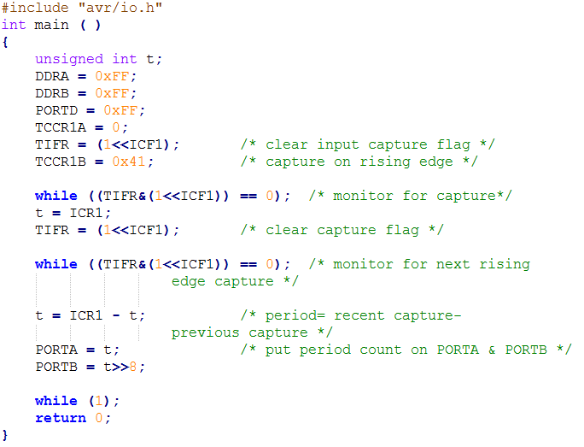
AVR Timer Input Capture Mode (ICU)
Example1:
Assuming that the clock pulses are fed into the pin ICP1, following program will read TCNT1 value at every rising edge and place the result on PORTA and PORTB.

Slide 42
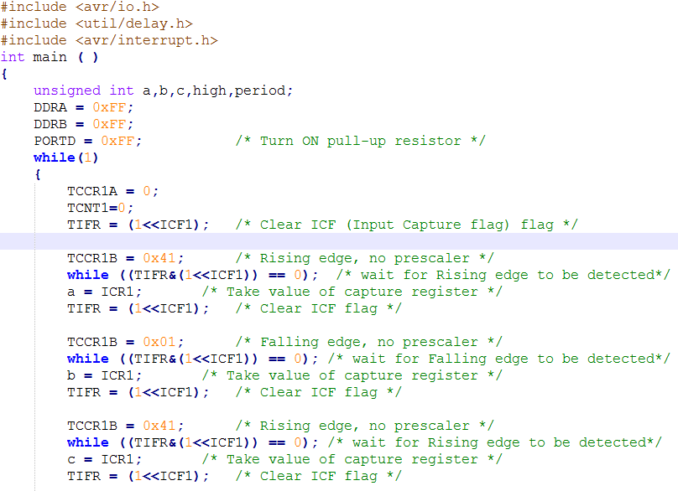
AVR Timer Input Capture Mode (ICU)
Example2:
We want to measure the frequency and duty cycle and displaying it on PORTA and PORTB.

Slide 43
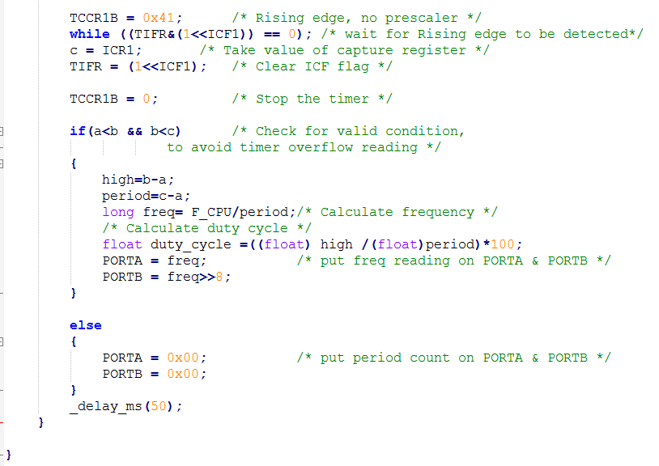
AVR Timer Input Capture Mode (ICU)
Example2:
We want to measure the frequency and duty cycle and displaying it on PORTA and PORTB.

Slide 44
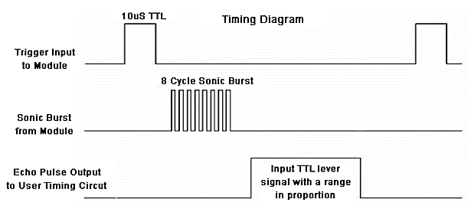
AVR Timer Input Capture Mode (ICU)
Example3 (Unsolved):
We want to measure the distance using Ultrasonic Sensor.
Ultrasonic Sensor:
This sensor uses a technique called “ECHO” which is something you get when sound reflects back after striking with a surface.
Ultrasonic sensor “HC-SR04” provides an output signal proportional to distance based on the echo. The sensor here generates a sound vibration in ultrasonic range upon giving a trigger, after that it waits for the sound vibration to return. Now based on the parameters, sound speed (340m/s) and time taken for the echo to reach the source, it provides output pulse proportional to distance.

Slide 45
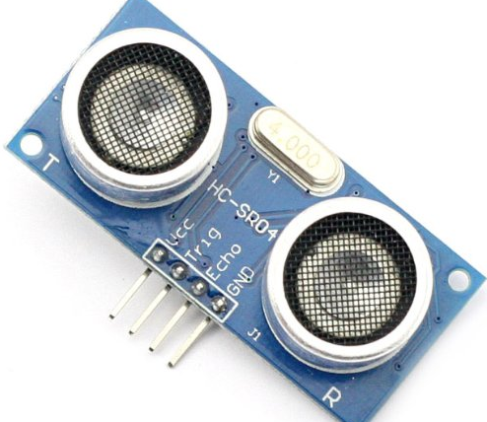
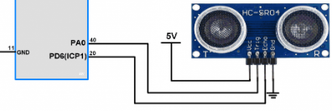
AVR Timer Input Capture Mode (ICU)
Example3 (Unsolved):
We want to measure the distance using Ultrasonic Sensor.
Ultrasonic Sensor Connection with MCU:
It consists of 4 pins (VCC, Trig, Echo, GND)
Trig pin: is connected with an output pin in MCU.
Echo pin: is connected with ICP pin (PORTB0).

Slide 46
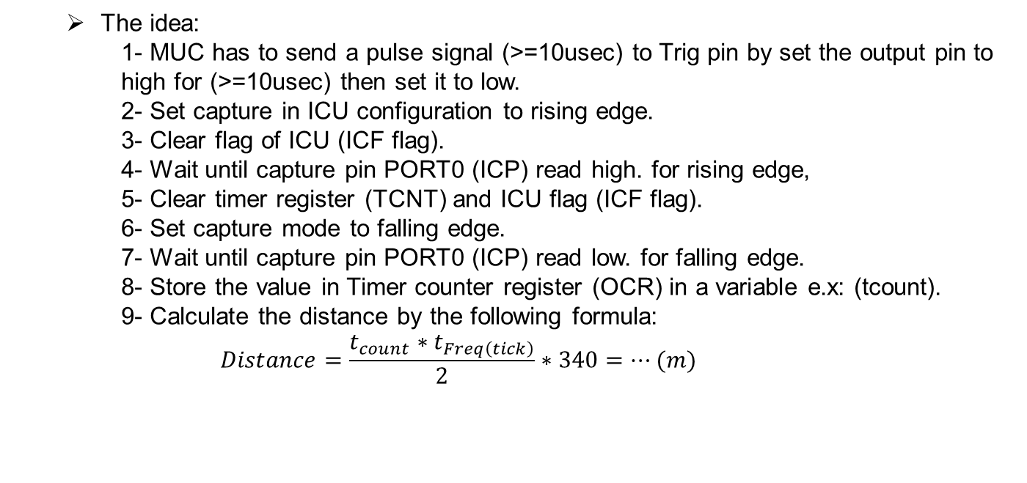
AVR Timer Input Capture Mode (ICU)

